Slide 1
μCavLab Final Presentation
Hongfei Chen, Jingyu Chen, Daniel Thomson, Scott Baker, Mohamed Khaled
31st May 2018

Slide 2
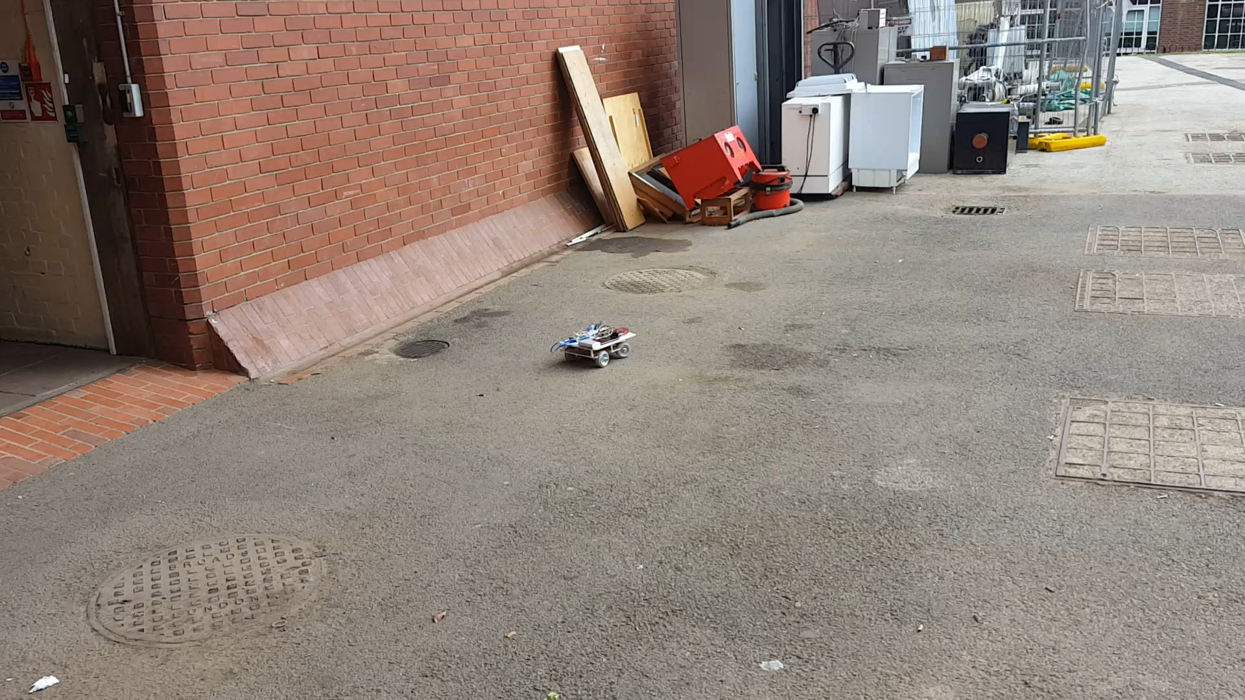

Slide 3
Overview
Project Review （Aims）
Individual Contributions
Limitations of Overall Project
Future Development
Questions & Discussion

Slide 4
Project Aims
•Develop a 1:6 scale drive-by-wire vehicle using Ackermann steering
•Create a μPod such that it uses a drivetrain with a control unit which can be programmed in the same way as the full-size model
— Same control system ROS (Robot operating system)
— Extensible for more sensors
•Use the μPod to test the code and algorithms originally developed for the full size model
•Achieve autonomous and remote control

Slide 5
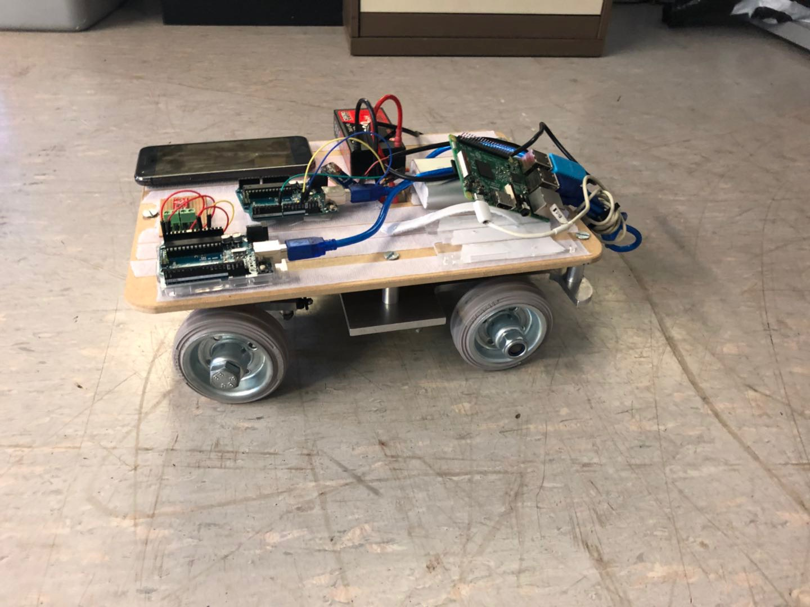
Vehicle Overall Review
μPod vehicle
Deployed with Raspberry Pi 3 and Arduino.
Total weight is 3.8 Kg.
Maneuverability:
Adjustable speed controller and steering system.
Function:
record map information
follow GPS waypoints
Control mode:
Autonomous mode
Remote control

Slide 6
Project Overall Review
Vehicle assembled within the size requirements
Ackermann steering system used
Servo has control issues
Rear axle differential incorporated
Vehicle can drive on a flat, smooth surface and on rougher surfaces found outside
Has issues starting from rest on an incline

Slide 7
Project Overall Review
Robot Operating System (ROS) framework compatible with code provided by Transport Systems Catapult (TSC)
Vehicle can be driven under remote control
Required map is recorded successfully
Autonomous function works successfully in theory
Unable to achieve autonomous control

Slide 8
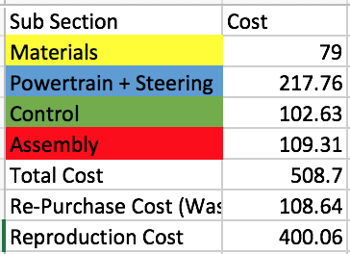
Budget & Expenditure

Slide 9
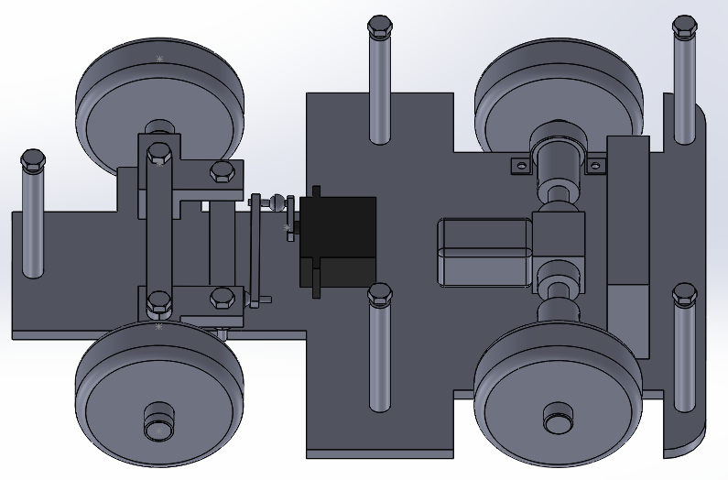
Project Review by Phases – Term 1
Initial vehicle concepts and design
Completed chassis and Ackermann steering final design and manufacture
Became familiar with the ROS environment
Critical components were purchased

Slide 10
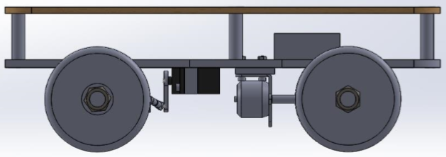
Project Review by Phases – Term 2
Completed detailed design of overall vehicle and individual components
Extensive manufacturing tasks were undertaken
The GPS component able to collect required data
Final wiring plan completed

Slide 11
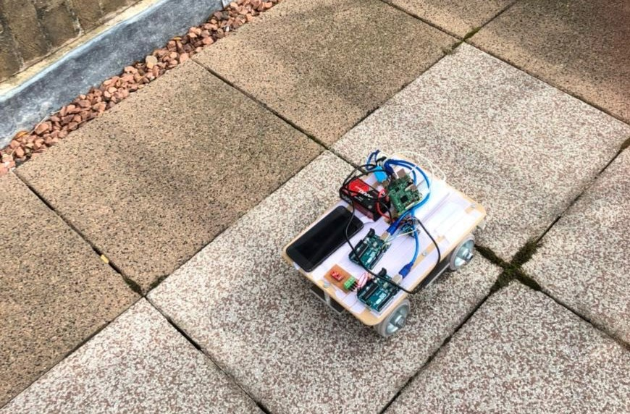
Project Review by Phases – Term 3
Manufacturing adjustments and final assembly
Mechanical testing and discovery of issues
Circuit assembled and drive-by-wire achieved
Overall vehicle testing and work required for optimisation highlighted

Slide 12
Individual Contribution – Daniel Thomson
Main responsibilities throughout the project have been:
In charge of the mechanical design of the vehicle
Designing the Ackermann steering system
Assembling the CAD model of the vehicle and making necessary changes to individual components
Producing engineering drawings of a wide range of components
Involved in assembly of the vehicle

Slide 13
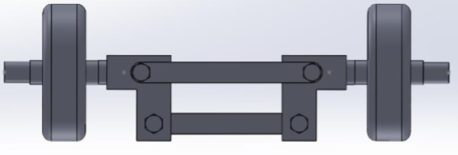
Ackermann Steering
First task was to design the Ackermann system- shown left
Lower shaft acts as the tie rod
This is where the steering arm is connected from the servo motor
Once this was designed could move onto the next part of the design

Slide 14
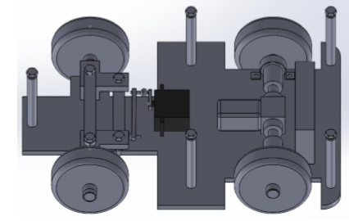
Initial Design
The image shows the first assembled design of the vehicle
More detail was required in particular in the rear axle
Needed to wait for the differential to arrive
Produced drawings for the Ackermann components and chassis supports

Slide 15
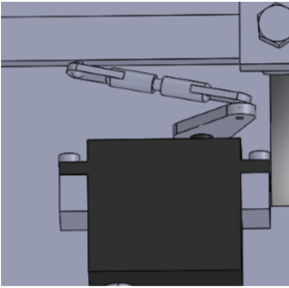
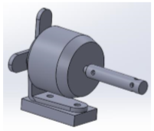
Detailed Design
Started completing the detailed design of the remaining components
Left image shows the servo steering arm
Right image shows the modelled motor with its mount

Slide 16
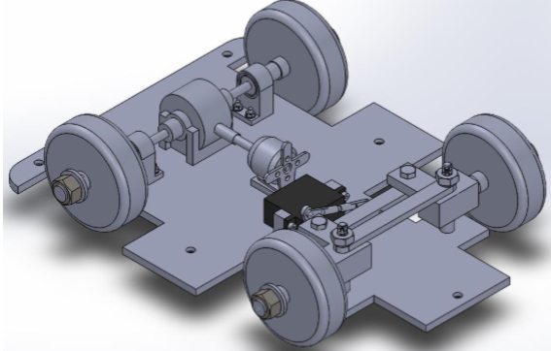
Detailed Design
Image shows the detailed design of the mechanical components
A number of further engineering drawings were completed:
threaded driveshaft
bearing housing
motor platform and motor shaft
left and right servo fastening
front axle wheel rod
updated chassis
front axle spacer

Slide 17
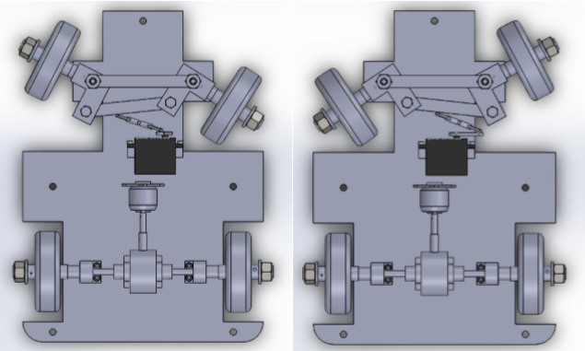
Steering Angles
Next I investigated the steering angles that would be returned
Left image shows 40° anticlockwise servo rotation
Right image shows maximum clockwise servo rotation
Both of these give an average steering angle of 30°

Slide 18
Final Design
Image shows the re-designed vehicle to combat the ground clearance issue
This was done to validate the solutions effectiveness
This was how the final vehicle would look once assembled
Finally I moved into helping make the design a reality

Slide 19
Individual Contribution – Scott Baker
Three main responsibilities:
• Designing drivetrain
• Drive component selection
• Assembly
First task after initial concept generation was to decide the drivetrain
Three options under consideration:
• AWD with a motor on each wheel
• RWD with motor on each wheel
• RWD with differential and one motor

Slide 20
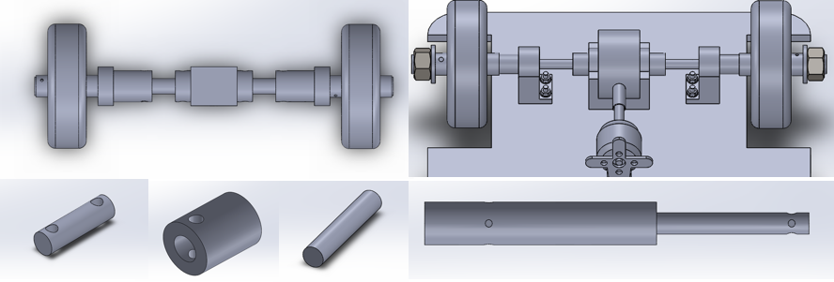
Drivetrain Design

Slide 21
Drive Component Selection
Wheel rpm @ 24km/h = 1932
Differential gear ratio 4.15:1
Motor rpm @ 24km/h = 8018 (78.5% of max)
Using 5-9A range, this relates to 8.14A
Assuming 0.2A servo draw
5/8.34 = 36 minutes battery life

Slide 22
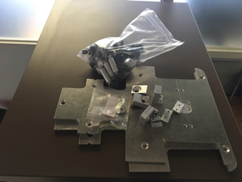
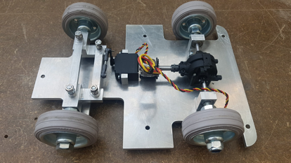
Assembly
•Final assembly of first pod
•Many modifications to parts and adjusting sizes of spacers etc.

Slide 23
Individual Contribution – Mohamed Khaled
In charge of coming up with a mechanical chassis design that incorporates the appropriate sensors and electrical components. Designing some other components required for the design assembly.
Producing appropriate design drawings which are then submitted into the mechanical workshop.
Sourcing acquiring cost quotes and selecting the appropriate source.
In charge of obtaining respective signatures for both purchase and request forms ahead of schedule.
Involved in mechanical sub-team design adjustments and final assembly of the vehicle.

Slide 24
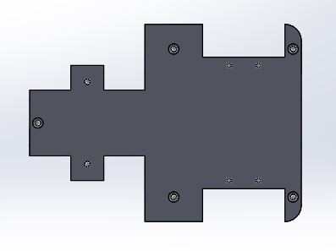
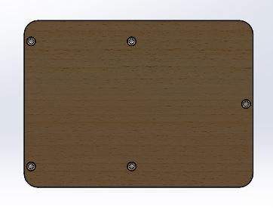
Chassis Design
The chassis involved a main base aluminium plate that was designed with respect to the mechanical mechanisms involved with the vehicle such as the Ackermann steering mechanism. This required for a wide space at the front of the chassis so as to not hinder steering in any way.
The wooden plate was designed to use the maximum dimensions to allow for a large area for the attachment of appropriate components

Slide 25
Sourcing, Purchase and Work Request
This involved identifying the materials to be used based on the mechanical design and calling the appropriate stores to attain cost quotes.
Purchase forms and work request forms were then filled out and the appropriate signatures were attained in order for submission.
However, due to some components arriving late such as the differential and some other unexpected events, there were delays, both to component arrival and form completion.

Slide 26
Delays
In order to combat these delays in the Engineering mechanical workshop, I decided to email Mr Andrew Underhill in the Physics lab , and attach some design drawings, to request some of our work be transferred there for manufacture.
This request was accepted, however, the time scale supplied was the same as that estimated.

Slide 27
Mechanical Workshop
It was decided, within the mechanical sub-team, that in order to complete the project at the set out time, and achieve the set out aims, we had to manufacture as many components as possible.
However, there remained a number of complicated components that required machining. These were therefore resubmitted to the workshop.
After the manufacturing stage had completed. I was involved in helping assemble the vehicle to allow for the testing phase to begin.

Slide 28
Individual Contribution – Hongfei Chen
Main responsibilities through the whole process:
Take charge of designing the micro-control unit structure and GPS module choice
Design and implement the wiring for the μPod
Test the speed control unit and build the vehicle motion node
Assist in the pod final testing

Slide 29
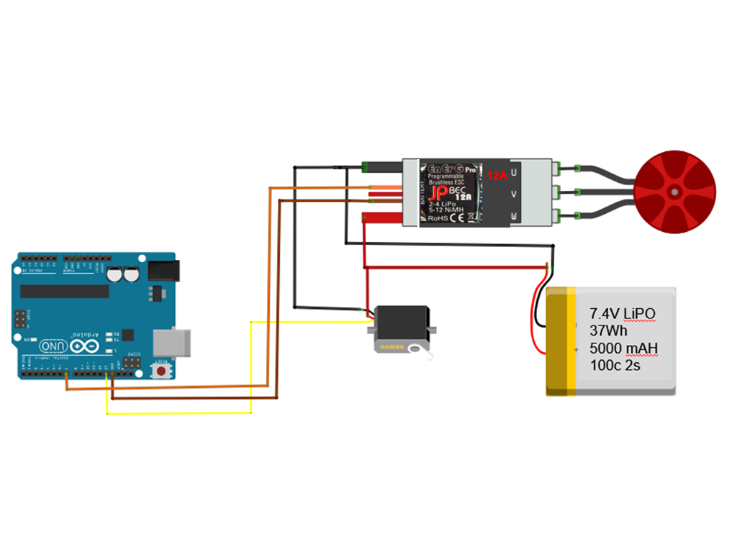
Speed and steer control wiring
The speed and steer control unit consists of a servo motor, ESC, motor and battery
The speed and the steering are tested through the Arduino servo library
Both are tested separately to find out the operating limits and to develop the functionality

Slide 30
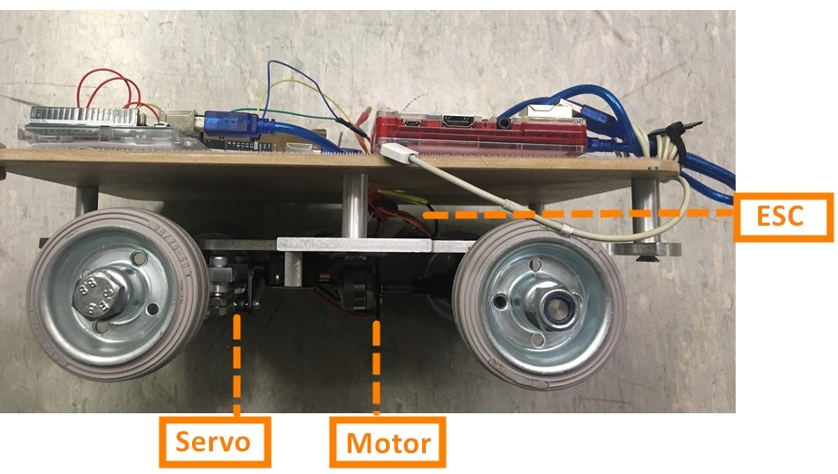
Wiring implementation
A 20mm*20mm hole was cut into the upper plate
The battery is moved to the upper plate, which is different from the original design

Slide 31
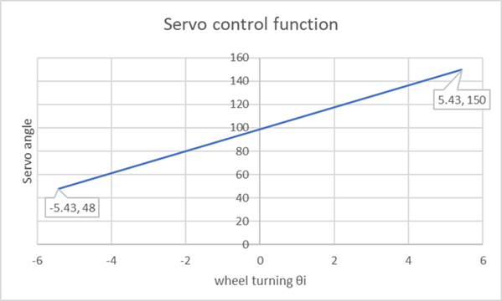
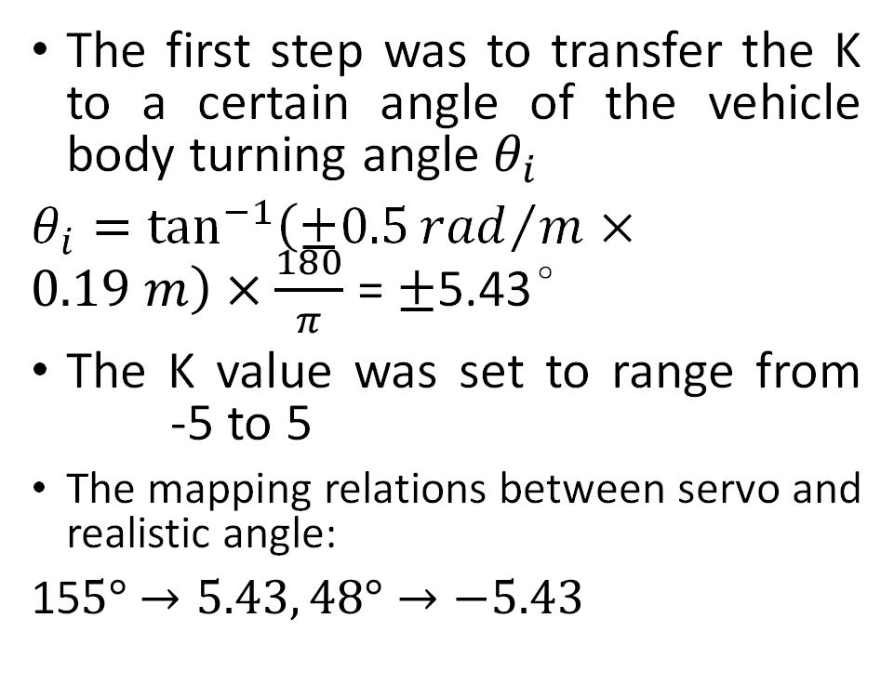
Vehicle motion node – steering function
The first step was to transfer the K to a certain angle of the vehicle body turning angle $θ_{i}$
$θ_{i}=\tan^{−1}\left(±0.5{rad}/m×0.19 m\right)×\frac{180}{π}$ = $±$5.43°
The K value was set to range from -5 to 5
The mapping relations between servo and realistic angle:
15$5°$ $→5.43, 48°→−5.43$

Slide 32
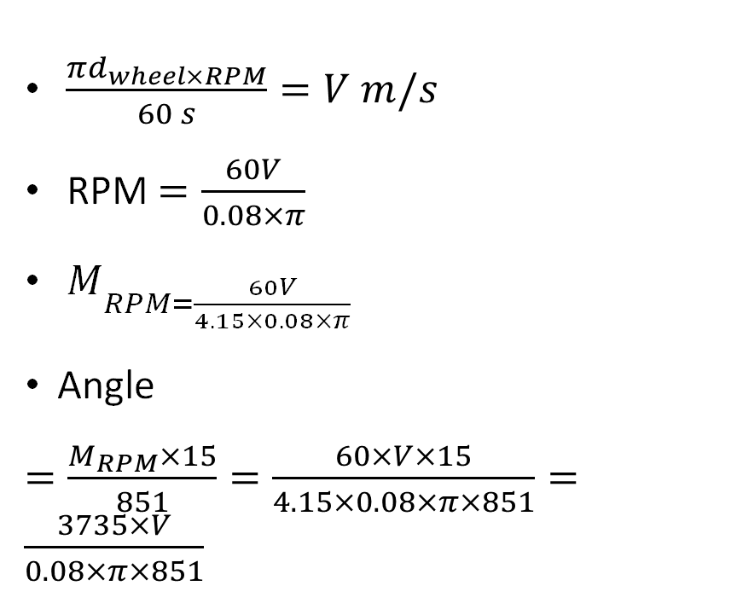
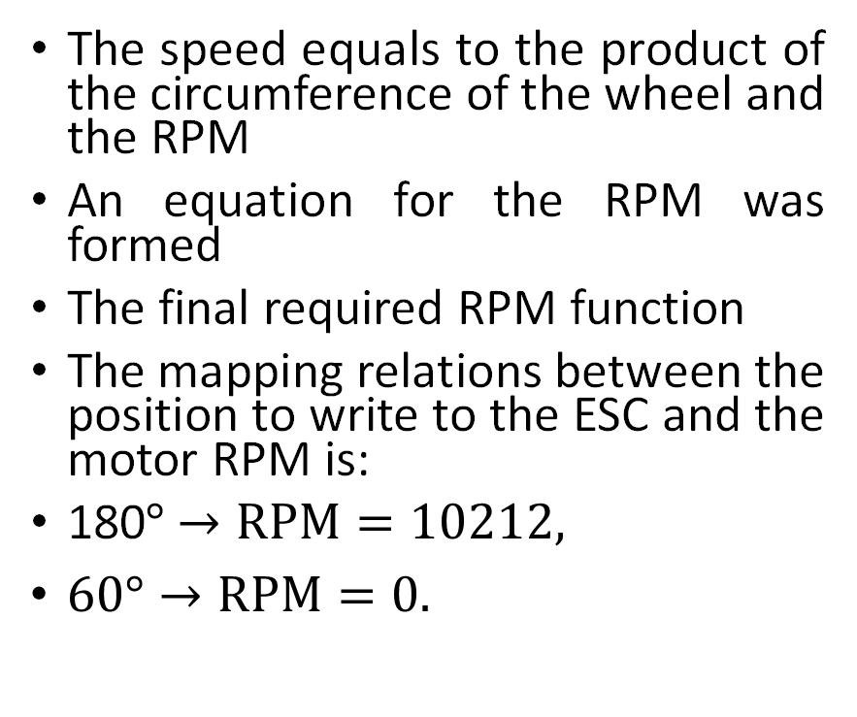
Vehicle motion node – speed function
The speed equals to the product of the circumference of the wheel and the RPM
An equation for the RPM was formed
The final required RPM function
The mapping relations between the position to write to the ESC and the motor RPM is:
180$°$ $→RPM=10212,$
$60°→RPM=0.$
$\frac{πd_{wheel×RPM}}{60 s}=V m/s$
RPM $=\frac{60V}{0.08×π}$
$M_{RPM=\frac{60V}{4.15×0.08×π}}$
Angle
$=\frac{M_{RPM}×15}{851}=\frac{60×V×15}{4.15×0.08×π×851}=\frac{3735×V}{0.08×π×851}$

Slide 33
Individual Contribution – Jingyu Chen
Main achievements:
Analyse and revise the software package provided by TSC
Install the development architecture and design the control system
Sensor testing and fusion
System integration and final testing

Slide 34
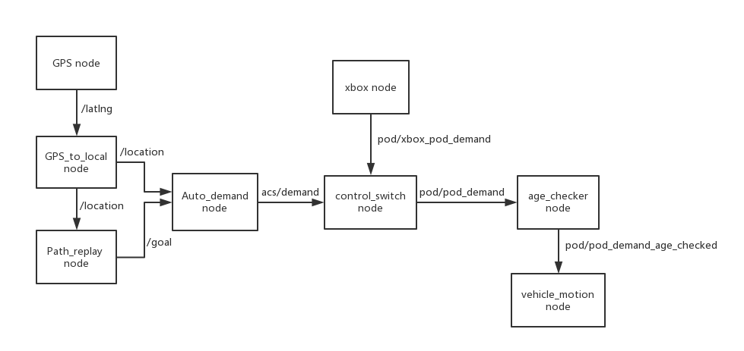
Software package analysis and revise
Catapult version
University version
Our changes:
Change GPS input and simplify some parts like Deadman switch and demand limiter
Add vehicle motion controller

Slide 35
Complete Node list
Nodes | package
nmea_serial_driver | nmea_navsat_driver
android_all_sensors_driver | android_all_sensors_driver
compass_node | sparkfun_compass
connection_node | connection
gps_to_local | b_acs
path_replay | b_acs
auto_demand | b_acs
joy_node | joy
control_switch | cavlab_core
age_checker | cavlab_core
motion_node | vehicle_motion
Nodes are just like c++ and python scripts and each node has its own function and can publish or receive the topics they need.

Slide 36
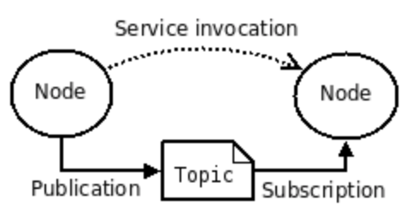
Architecture Establishment
All software control is based on Robot Operating System (ROS) and is written as a series nodes
ROS is built on Ubuntu mate system in Raspberry PI
Limitation is the memory of RPI is only 512M and when we launch the whole project the computer will crash.
Solution is to sacrifice the SD card memory to increase the swap space of RPI

Slide 37
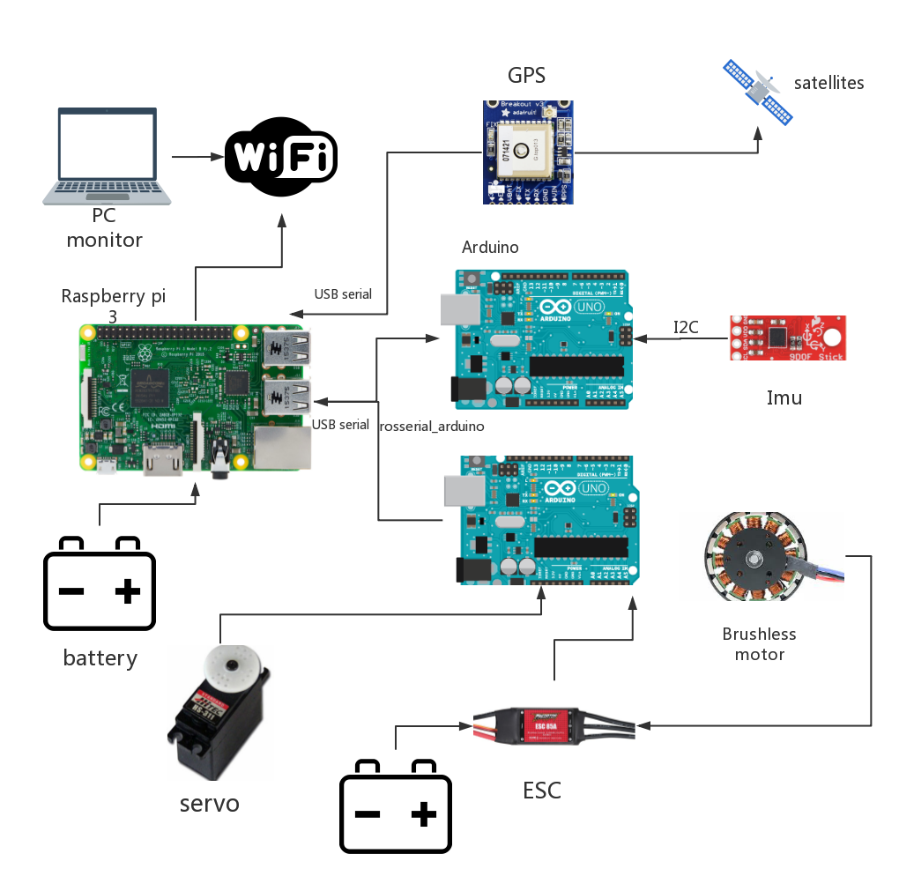
Control System Design
Main control unit:
Raspberry Pi 3
Auxiliary control unit:
Arduino
Sensors:
GPS and Inertial Measurement Unit (IMU)
Electrical components:
ESC, Servo and motor
Power:
7.4v lithium battery and 5V power bank

Slide 38
GPS Testing
Parse raw NMEA data and get latitude and longitude information
$GPGGA,181908.00,3404.7041778,N,07044.3966270, W,4,13,1.00,495.144,M,29.200,M,0.10,0000*40
Integrate ROS with the hardware and use a node to publish latitude and longitude at 1 Hz
Problem is the publishing rate and precision
Need better filter to process the raw data which has many errors

Slide 39
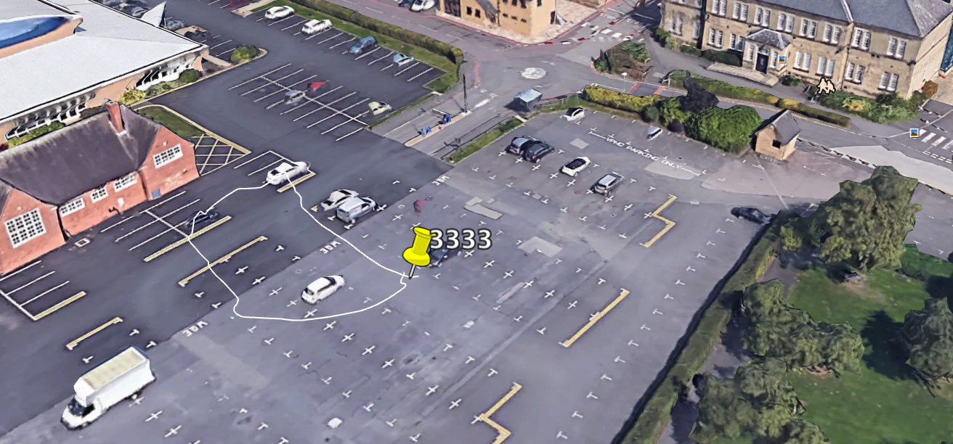
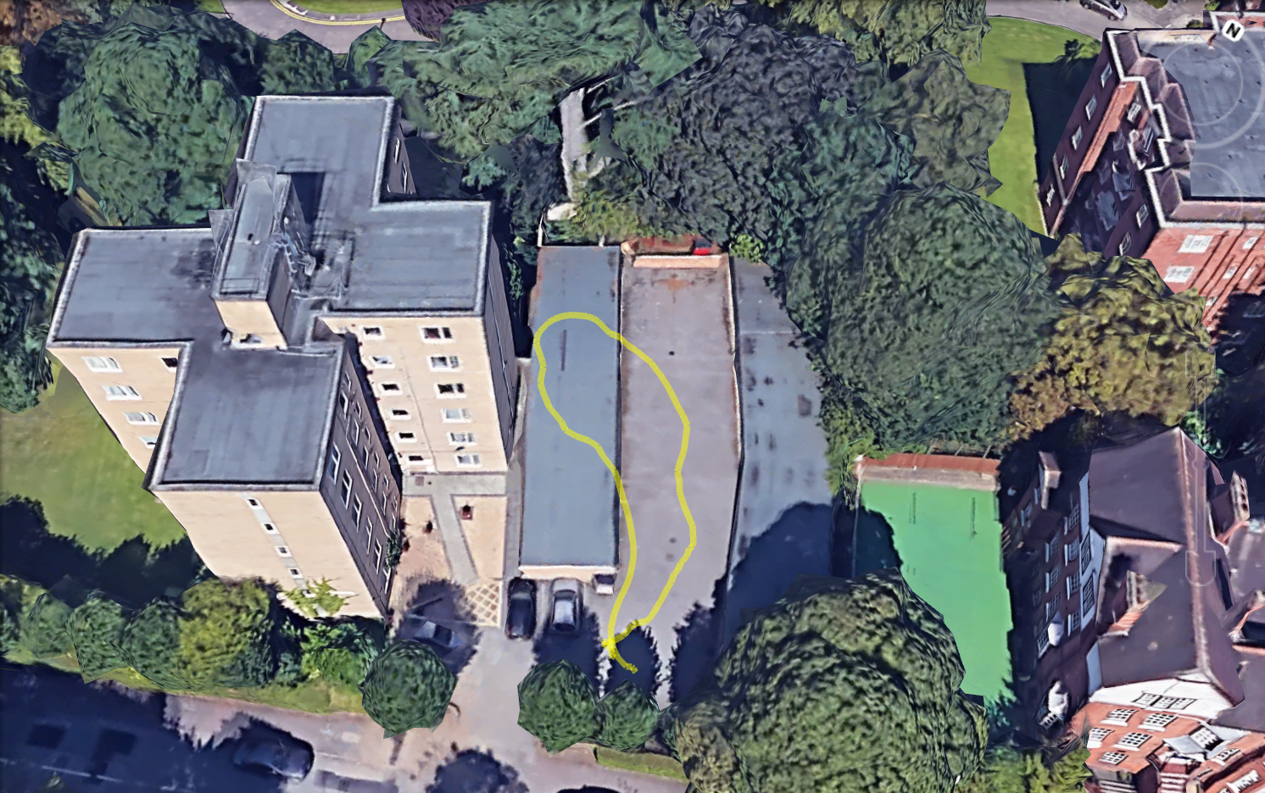
In the car park
Near the tall building
When we use GPS to record the map, it is better to stay away from tall buildings.
From the past experience, GPS’s signal from android phone has better performance than that we bought from the Adafruit company.

Slide 40
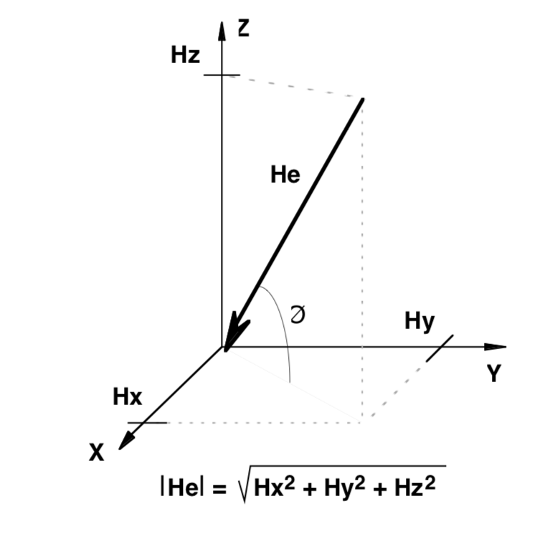
IMU Testing
IMU consists of three components:
3-axis magnetometer
3-axis accelerometer
3-aix gyroscope
We only use magnetometer to calculate the heading angle
Direction (y>0) = 90 - [arcTAN(x/y)]*180/ Pi
Direction (y<0) = 270 - [arcTAN(x/y)]*180/ Pi
Direction(y=0,x<0)=180.0
Direction (y=0, x>0) = 0.0
Main equation: heading angle = arctan(x/y)

Slide 41
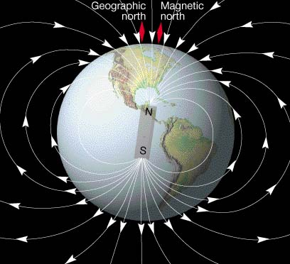
Calibration of IMU
Consider declination angle between geographic north and magnetic north
IMU can’t provide precise heading angle without calibration.
We use A function is designed using FIFO to accumulate the magnetic data. Find the maximum value and minimum value of magnetic field. Then average and scale the data and subtract the result of biases to remove the error.
Roll and pitch will definitely influence the heading angle

Slide 42
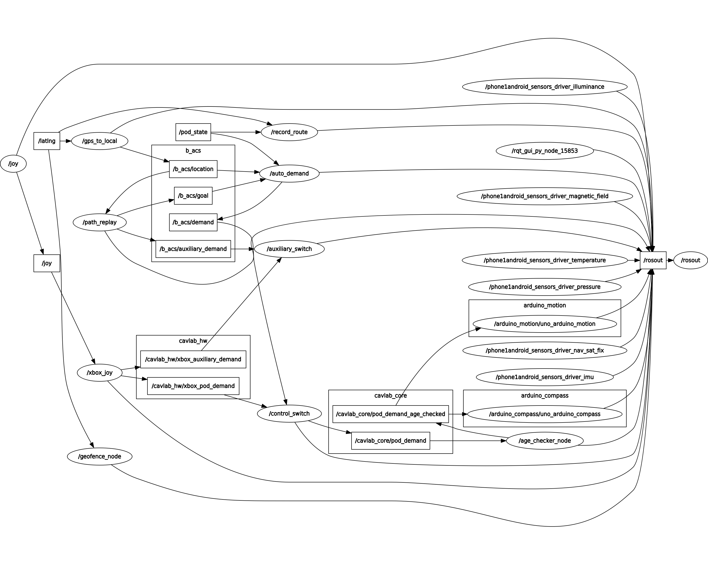
Final Test
Theoretically, we launch all the nodes but some nodes may need to debug which is beyond our ability

Slide 43
Project Limitations - Electronic
No proportionality between the joystick and servo position (all or nothing)
Delay between the input and output
Error in input signals means that the output is noisy
Have inadequate time to develop and debug the software package
Do not have enough budget to purchase sensors with high enough accuracy

Slide 44
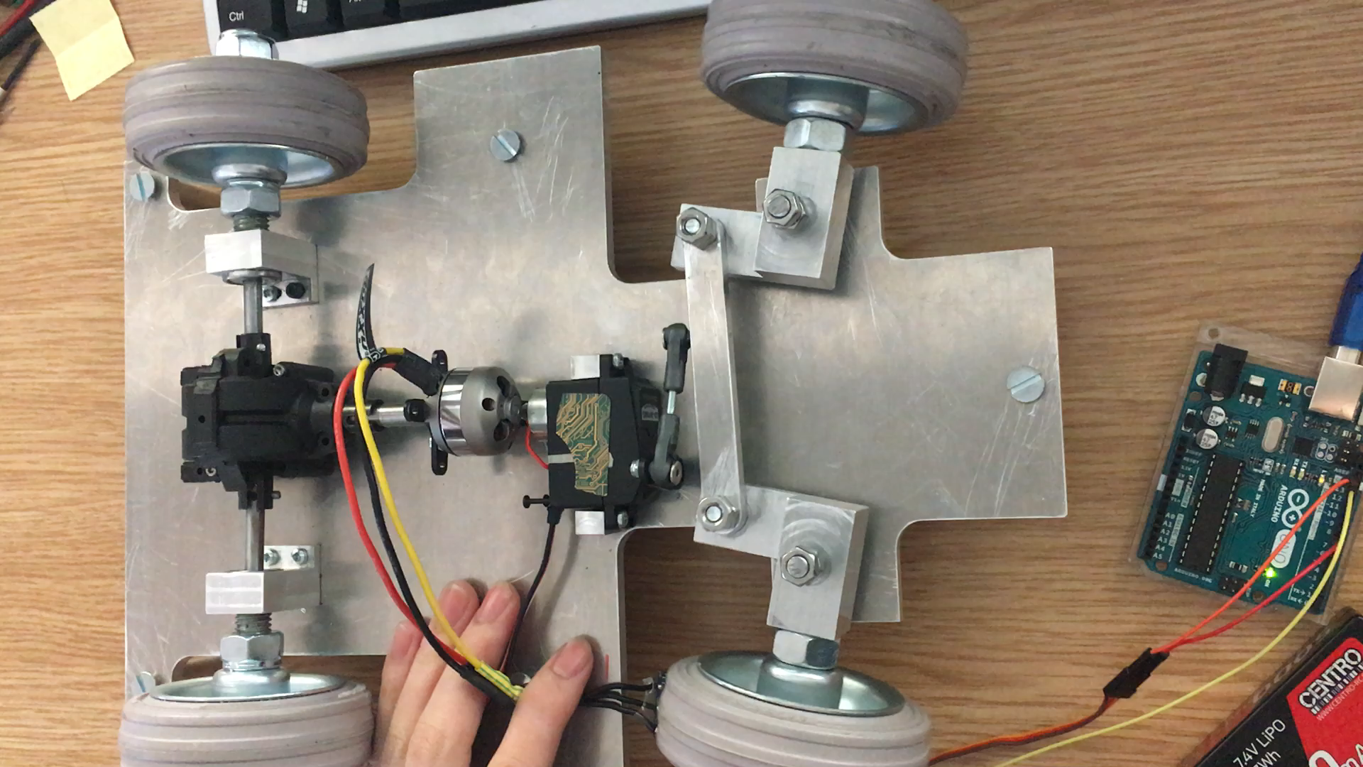
Project Limitations - Mechanical
Steering system can become locked when steering fully clockwise
This is due to the off-centre connection to the tie rod
Could be remedied by limiting the rotation of the servo

Slide 45
Project Limitations - Mechanical
Can set off from rest on a flat, smooth surface easily
Can't overcome any slight incline or bump in the road when stationary
If the vehicle is already at speed (within motor power band) it is able to overcome bumps and inclines

Slide 46
Further Work
Simplify the design
Add cosmetic attachment to the vehicle
Debug the code to achieve fully autonomous function
Change control unit to achieve backwards motion
Add Hall Effects sensor and incorporate a more sophisticated speed and steering controller
Design a better filter to remove the error of signal to achieve better precision of sensors.
More testing

Slide 47
Cheltenham Science Festival
We are showcasing our project to inspire the future generation of aspiring engineers
As the centre piece of our stand we will have the actual model vehicle that we have designed and built.
To supplement this we will have a screen showing a rolling PowerPoint presentation containing pre-prepared videos of our vehicle.
Alongside this we will show our vehicle design and the real time GPS data collection

Slide 48
Questions & Discussion
Thank you for listening and we would like to answer any questions you have about the project

